Slide 1
Missionary Nurses Training
Stockton, CA
May 4, 2013

Slide 2
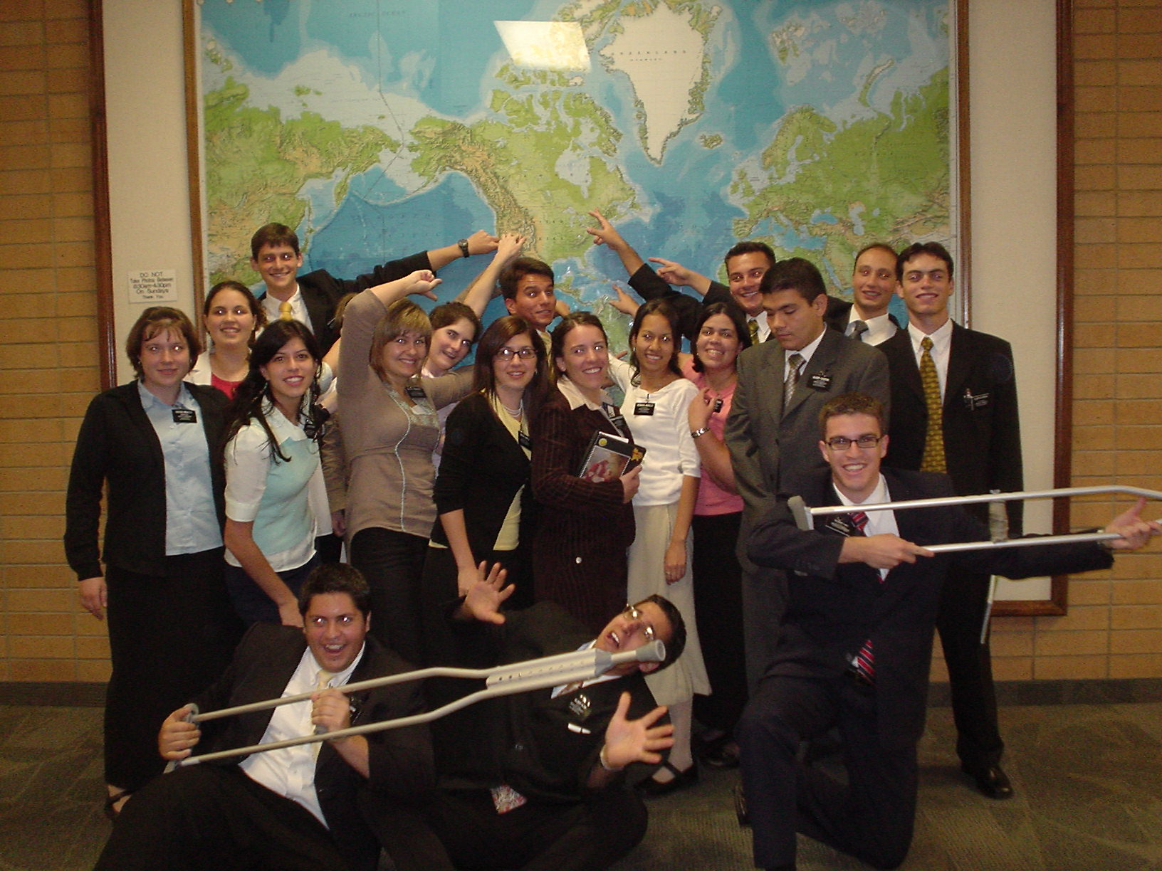
Missionaries Our Most Important Client

Slide 3
What We Want to Do:
Topics:
  MOQ
  Depression
  Anxiety/Stress
  Questions and Maybe some Answers

Slide 4

MOQ 45
Total Score:
  Score range from 0-180
  63 is considered the cut-off score for patient from non-patient.

Slide 5
Subscales
Symptom Distress (SD): items reflect symptoms of anxiety, stress and affective related problems.
  Cutoff score: 36
  Interpersonal Relationship (IR): items reflect symptoms of loneliness, conflicts with others, etc.
  Cutoff score: 15
  Social Role (SR): items reflect difficulty in the social roles of the missionary
  Cutoff score: 12

Slide 6

Depression
Common Symptoms:
  Fatigue
  Sleep problems
  Guilt/worthlessness
  Difficulty thinking/concentrating
  Possible suicidal thoughts/plans
What To Do:
  The ABC Model
  Destructive Thinking
  Journal of thoughts/moods

Slide 7

Anxiety and Stress
Common symptoms:
  Tired
  Irritability
  Sleep problems
  Feelings of inadequacy
  Possible panic symptoms
  Destructive thoughts

Slide 8
What To Do
Review the Handout

Slide 9
Questions and Answers

